Slide 1
BME 790 Spring 2017 Weekly Summary
Author: Daniel A Hagen
Week: 02/06/17-02/12/17
Relevant Topics: mobile articulated systems, Jacobians, generalized body frames

Slide 2
Mobile Articulated Systems
An articulated system is completely defined by the location and orientation of its body frame (i.e., its position – g ) and the variable(s) that reflect the relative placement of the component rigid bodies w.r.t. the body frame (i.e., its shape – r).
The remaining frames (and therefore any point on a given rigid body) can then be defined by position and shape through the kinematic model.

Slide 3
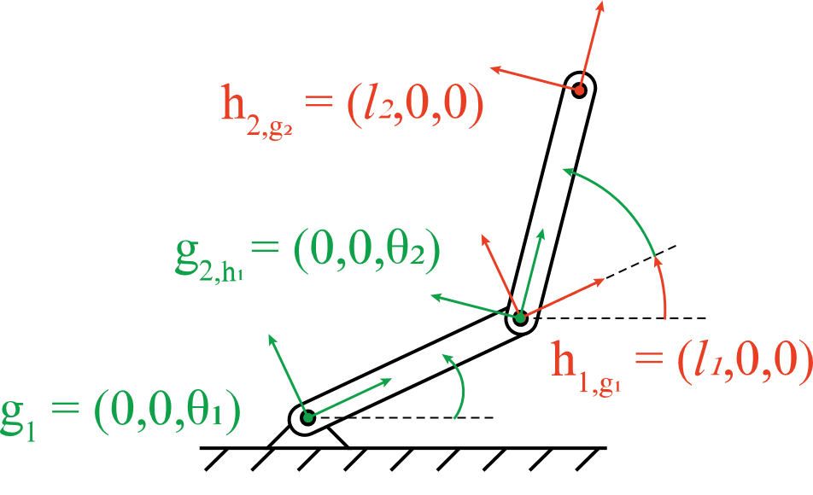
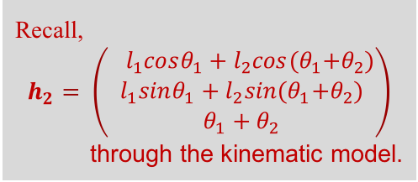
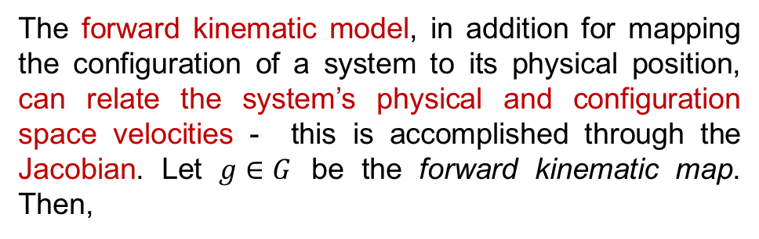
Jacobians
The forward kinematic model, in addition for mapping the configuration of a system to its physical position, can relate the system’s physical and configuration space velocities - this is accomplished through the Jacobian. Let $g∈G$ be the forward kinematic map. Then,
Therefore, the Jacobian through differentiation is:
For the 2-link, 4 DOF system (B) previously discussed:
is the Jacobian of the system. Discussed now are two ways in which the Jacobian can be found; differentiation of the kinematic map & by finding the Jacobian of each individual joint.
Recall,
$$h_{2}= \left(\begin{aligned}{ l}_{1}cosθ_{1}+l_{2}cos{(θ}_{1}+θ_{2}) \\ l_{1}sinθ_{1}+l_{2}sin{(θ}_{1}+θ_{2}) \\ θ_{1}+θ_{2}\end{aligned}\right)$$
through the kinematic model.

Slide 4
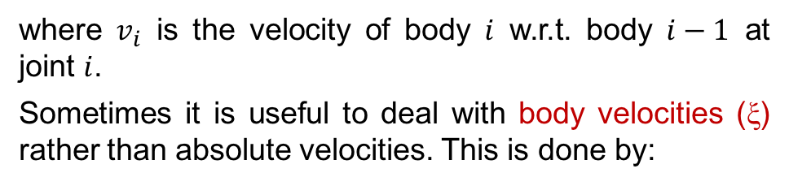
Jacobians (cont.)
The second way of finding the Jacobian is to follow an iterative assembly along the links of the system. This allows for a “pre-differentiation” of the relative movements of links as (1) velocities of any two frames on the same rigid body are linked by the right lifted action and (2) velocities at the joints are equal, modulo the relative motion allowed by the joint constraint.
From this approach it can be seen that, in general,
where $v_{i}$ is the velocity of body $i$ w.r.t. body $i−1$ at joint $i$.
Sometimes it is useful to deal with body velocities (ξ) rather than absolute velocities. This is done by:

Slide 5
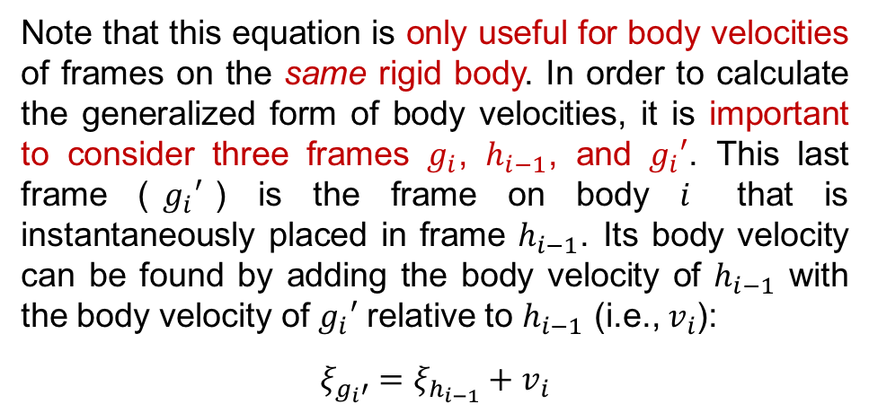


Jacobians (cont.)
Jacobians (cont.)
Because $g_{i}$ and $g_{i}^{′}$ are on the same rigid body, we can solve for $ξ_{g_{i}^{ }}$from $ξ_{g_{i}^{ ′}}$.
(Note that if the $x, y$ components of $g_{i}$ and $g_{i}^{′}$ are equal, then this conversion is simply rotational.)
Note that this equation is only useful for body velocities of frames on the same rigid body. In order to calculate the generalized form of body velocities, it is important to consider three frames $g_{i}$, $h_{i−1}$, and $g_{i}′$. This last frame ($g_{i}′$) is the frame on body $i$ that is instantaneously placed in frame $h_{i−1}$. Its body velocity can be found by adding the body velocity of $h_{i−1}$ with the body velocity of $g_{i}′$ relative to $h_{i−1}$ (i.e., $v_{i}$):
$$ξ_{g_{i}′}=ξ_{h_{i−1}}+v_{i}$$
These values can then be substituted back into the original equation to reveal the general form for the conversion of one distal frame body velocity to the distal frame body velocity of the adjoining link.
Additionally, if the frames are reduced to strictly relative frames, then the equation reduces even further to,

Slide 6
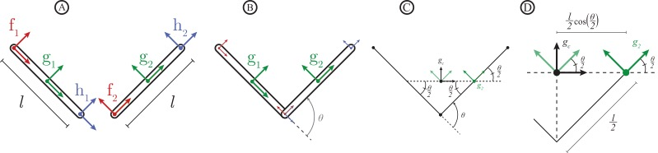
Generalized Body Frames
The body frame for either formalation can be chosen to be any frame (attached or floating) as long as each attached frame defined w.r.t. the chosen body frame is a function of the shape parameters. Note that the simplest choice for body frame is an attached body frame as it automatically satisfies this criterion. For this two-link, 4 DOF system, the choice of body frame is adequate because the attached frames are completely defined by transforms that are functions of the shape parameter (𝜃).

Slide 7
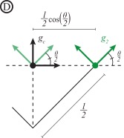
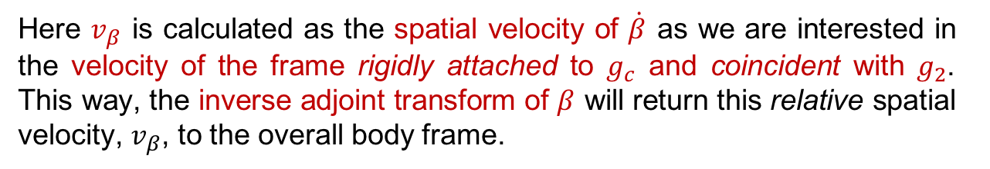
Generalized Body Frames (cont.)
As the transform to the overall body frame is a function of the shape parameter (defined as the position and orientation of any frame w.r.t. the overall frame), it is possible to convert from the (more easily obtained) body velocity for any attached frame to the overall body velocity, which is generally more difficult to obtain analytically.
Here $v_{β}$ is calculated as the spatial velocity of $\dot{β}$ as we are interested in the velocity of the frame rigidly attached to $g_{c}$ and coincident with $g_{2}$. This way, the inverse adjoint transform of $β$ will return this relative spatial velocity, $v_{β}$, to the overall body frame.

Slide 8
Conclusions/Impressions
The calculation of Jacobian operators allows for insight into the relationship between configuration velocities and the physical velocities of the system. But perhaps more interesting, there are individual approaches to deriving this operator that help to reveal key features about the system (e.g., the body frame velocities of each link and physical velocities at each joint through the joint-by-joint Jacobian formulation).
It is also important to have a transform operator that allows for the conversion of the potentially easier-to-derive equations of motion of attached frames to the physical velocity of any overall body frame (so long as this transform is a function of the system’s shape). This will be revisited later when determining optimal overall frames.
Biomechanically speaking, this could be potentially useful for evaluating equations of motion from an arbitrary frame (such as the center of gravity) by first evaluating the equations of motion for the links of the system. Additionally, it could also be useful to know the physical velocities of each joint (as opposed to only knowing the endpoint velocity found through the differentiation approach for deriving the Jacobian).

